Slide 1
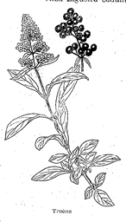
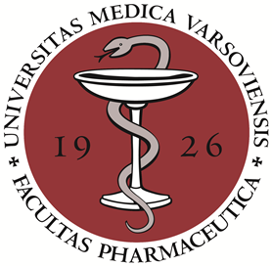
The Oleaceae family plants as a source of oleuropein derivatives with anti-inflammatory activity
Anna.K. Kiss
Medical University of Warsaw, Institute of Pharmacy,
Department of Pharmacognosy and Molecular Basis of Phytotherapy

Slide 2
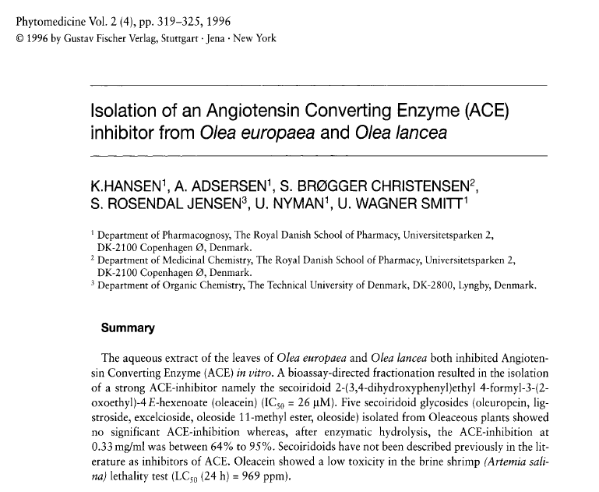

Slide 3
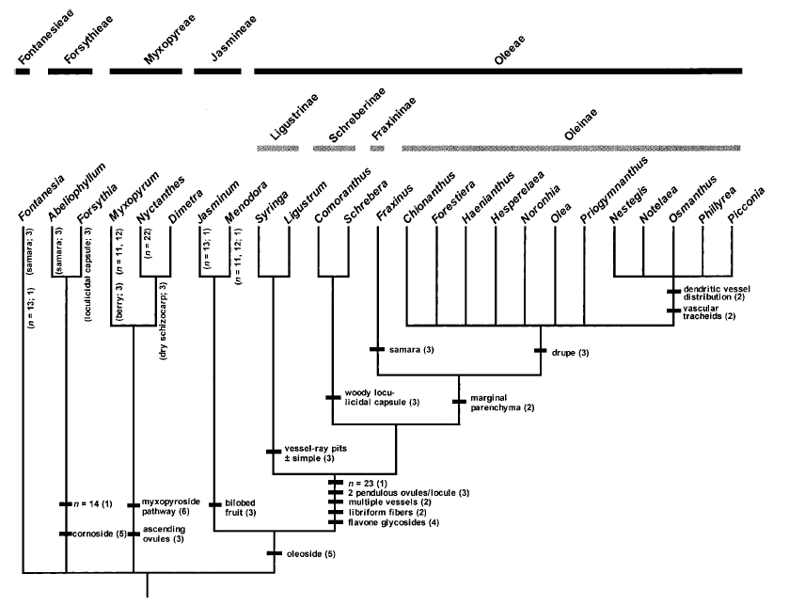

Searching from plant growing in central Europe

Slide 4
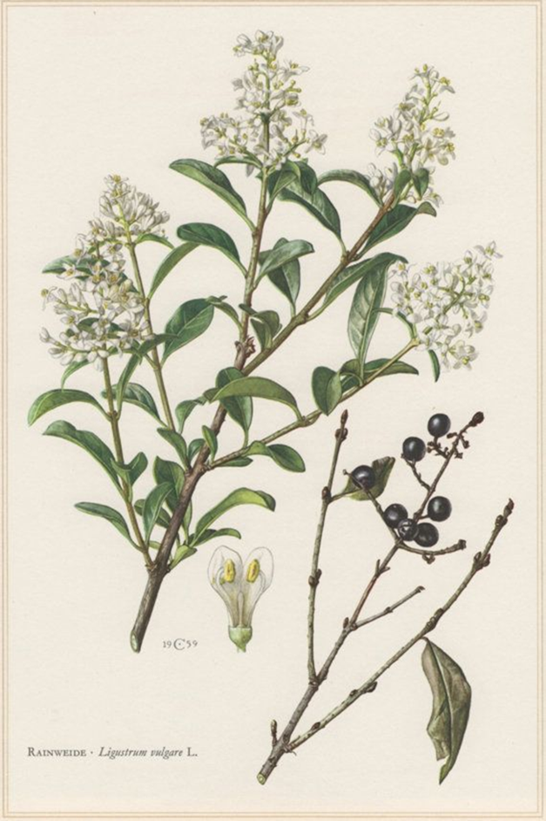
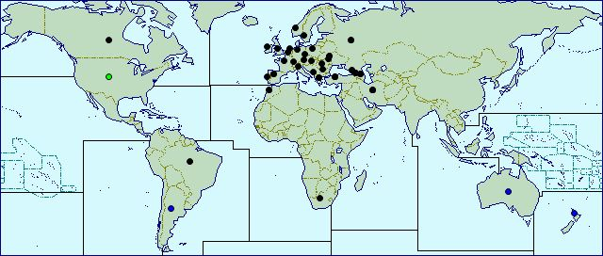
Distribution of common privet
Domain: Eukaryota
Kingdom: Plantae
Phylum: Spermatophyta
Subphylum: Angiospermae
Class: Dicotyledonae
Order: Oleales
Family: Oleaceae
Genus: Ligustrum
Species: Ligustrum vulgare
http://www.cabi.org/isc/datasheet/30764

Slide 5
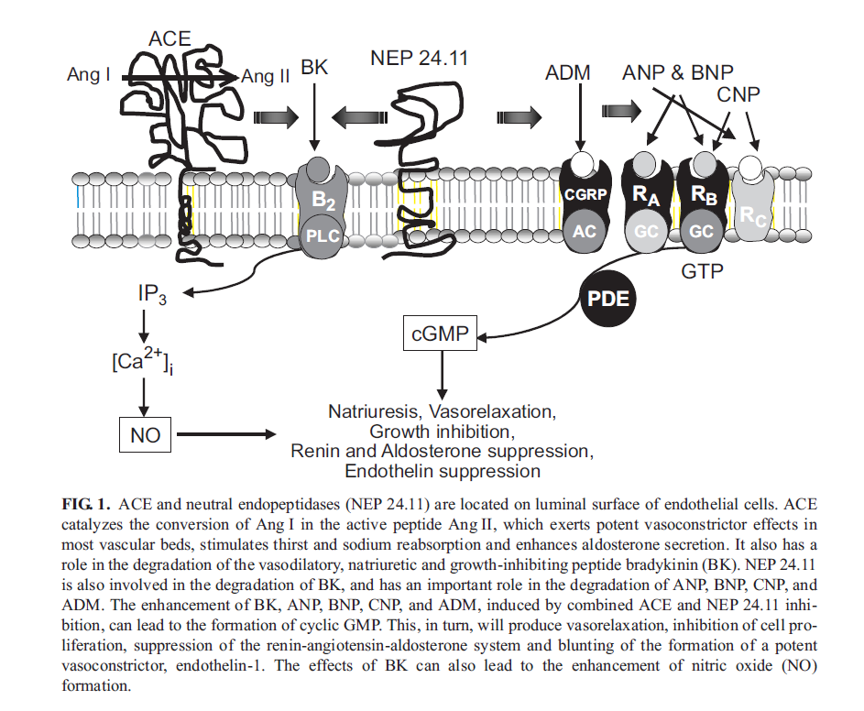

Slide 6
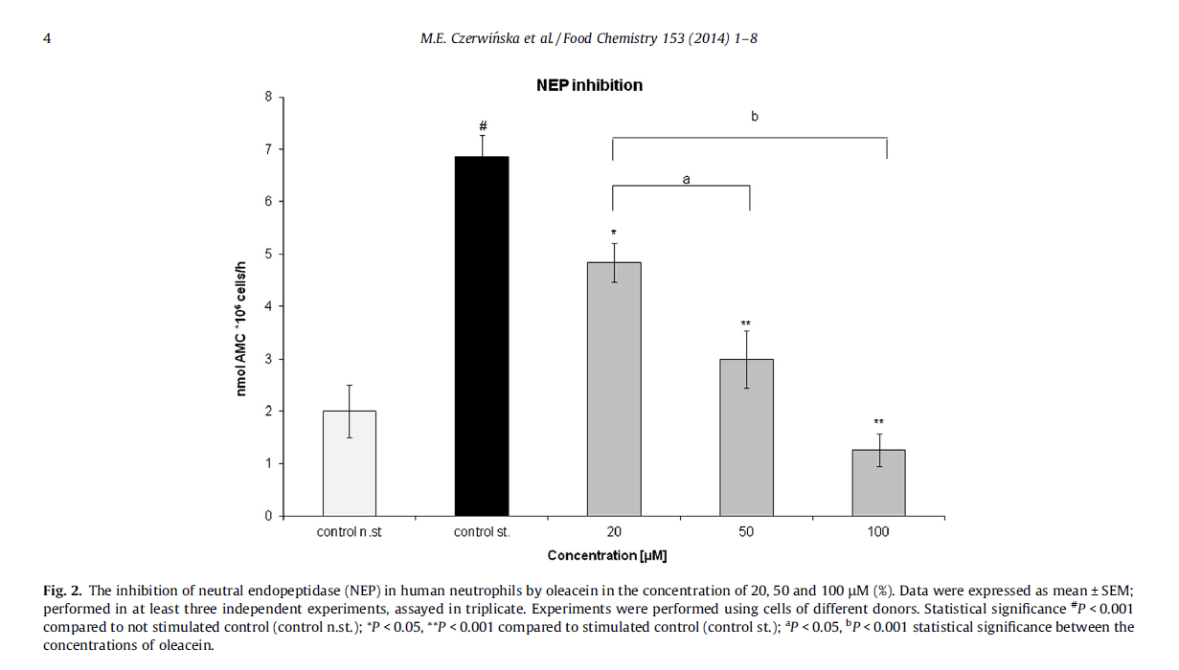
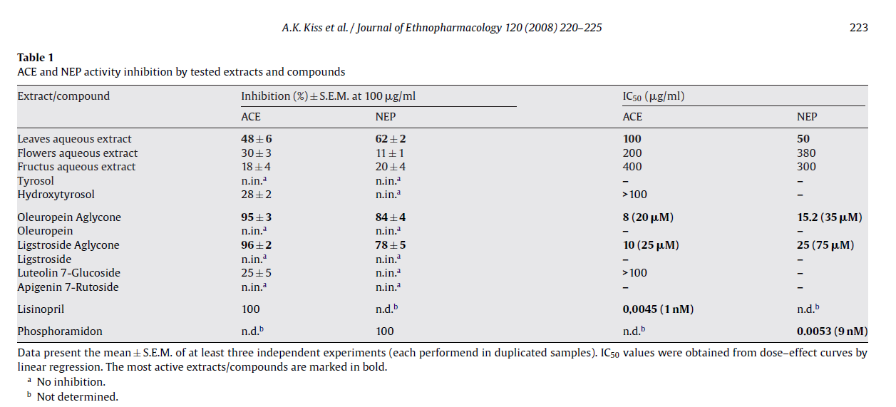
Dual inhibitors of ACE and NEP from
Ligustrum vulgare

Slide 7
Traditional use of common privet
Analgesic: leaves have been chewed against teeth ache; decoctions of leaves were considered to be effective in headache
Anti-inflammatory: leaves have been chewed against oropharyngeal inflammations, aphthae; infusions used for rinsing and treating mouth and throat wounds; infusions as anti-rheumatic agent
Antonone R et al. Traditional phytotherapy in the Roccamonfina volcanic group, Campania, southern Italy.
J Ethnopharmacol 1988; 22: 295–306
Arnold N et al. The antirheumatic plants of Cyprus. Ethnopharmacologie: sources, méthodes, objectifs. I Actes
du 1er Coloque Européen dʼEthnopharmacologie. Metz, Paris: ORSTOM;1993: 181–197
Scherrer et al. Traditional plant use in the areas of Monte Vesole and Ascea, Cilento National Park (Campania, Southern Italy). J Ethnopharmacol 2005; 97: 129–143
Popović et al. Wild flora and its usage in traditional phytotherapy (Deliblato Sands, Serbia, South East Europe. Indian J Tradit Know 2014; 13: 9-35

Slide 8
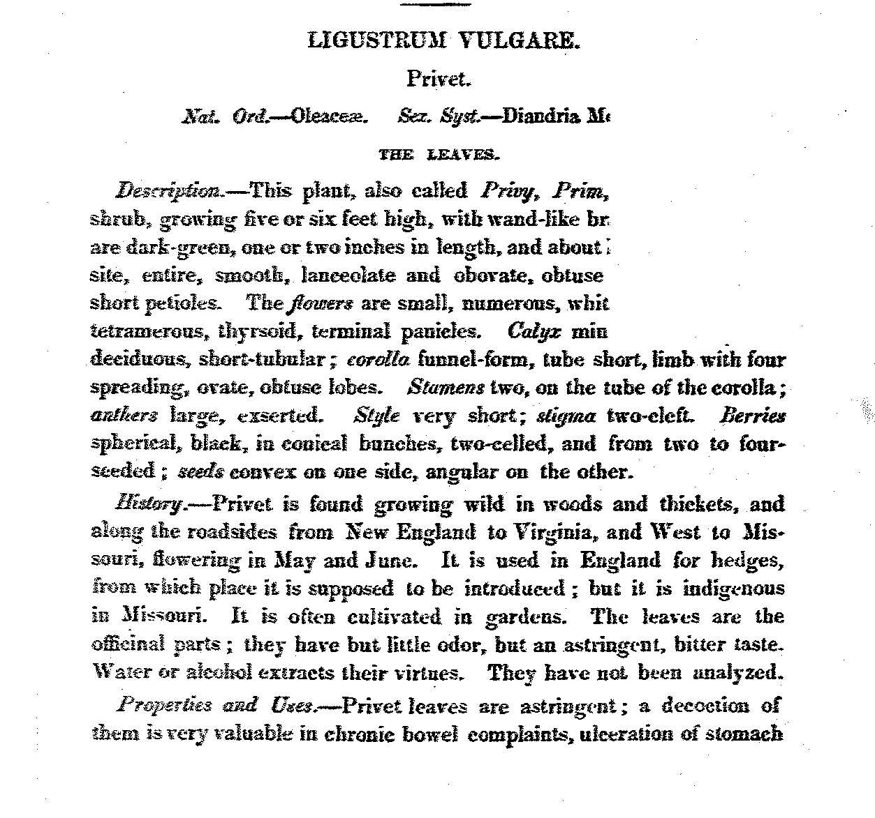
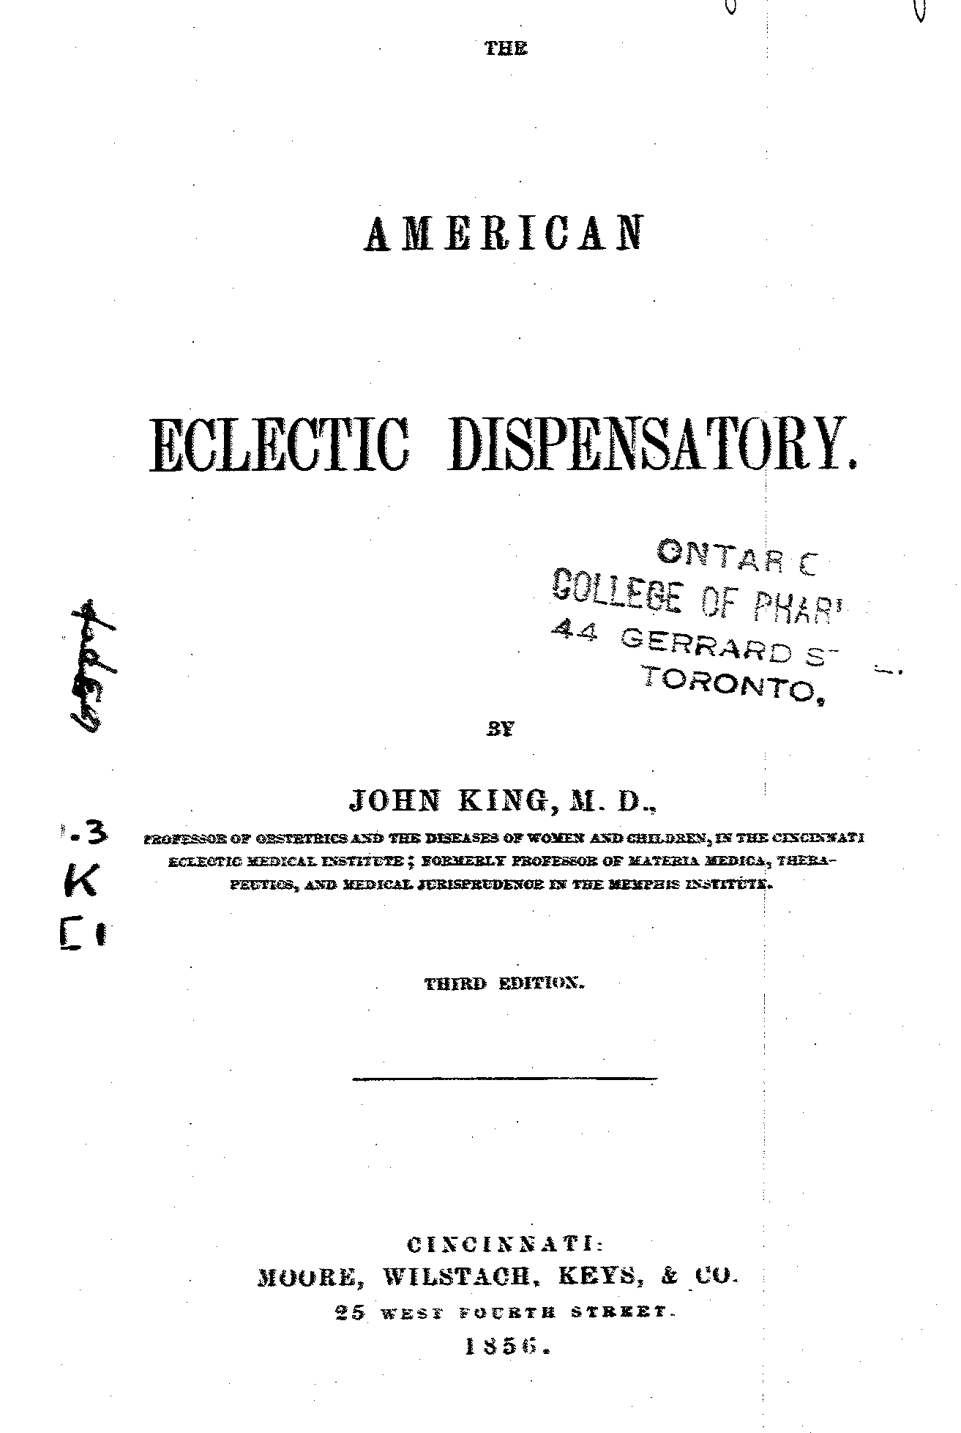
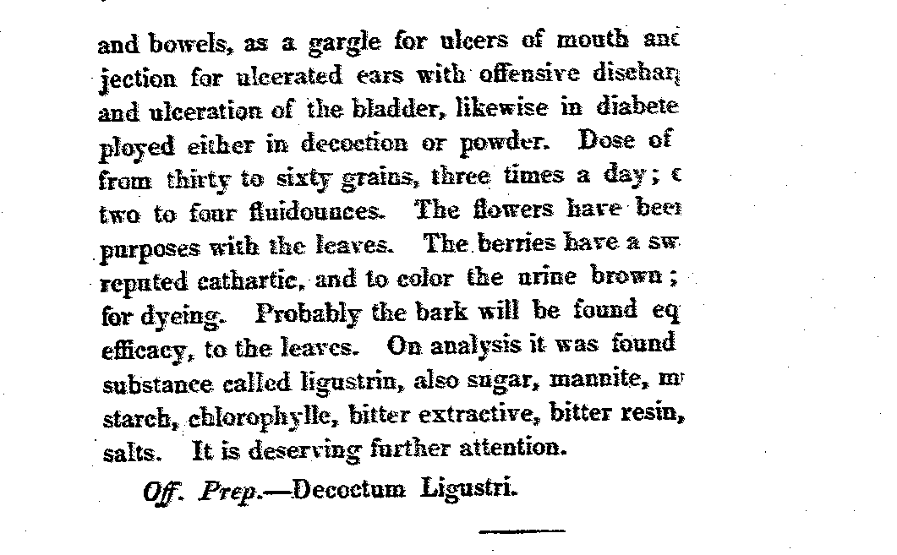
Traditional use of common privet

Slide 9
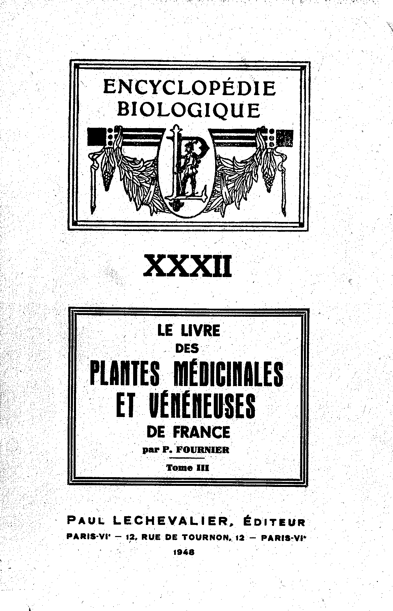
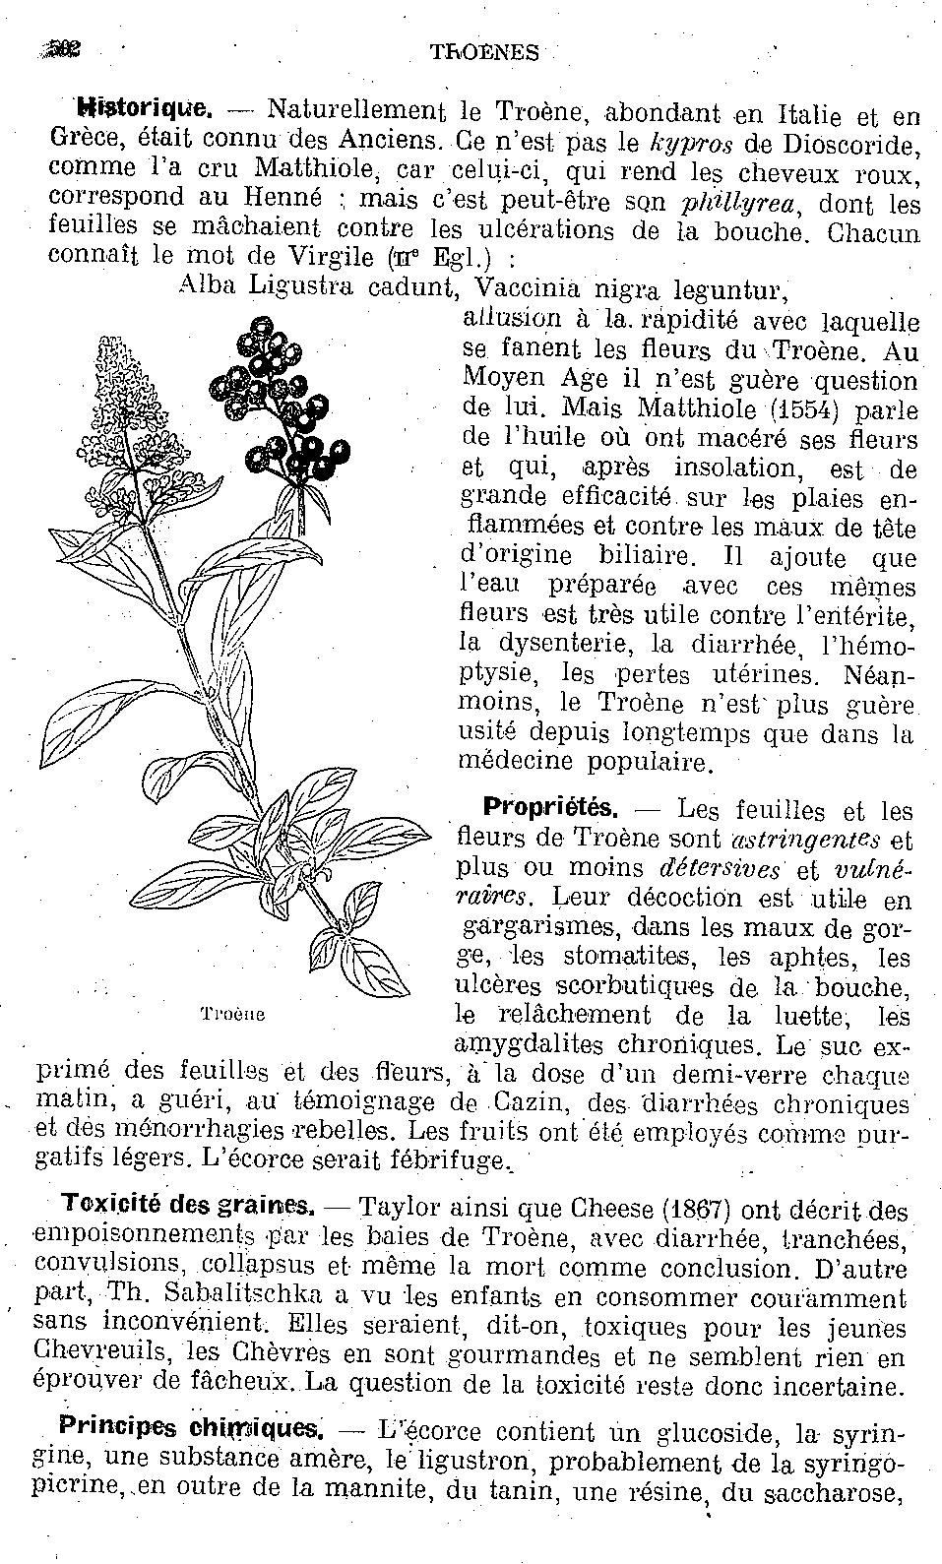
Traditional use of common privet

Slide 10
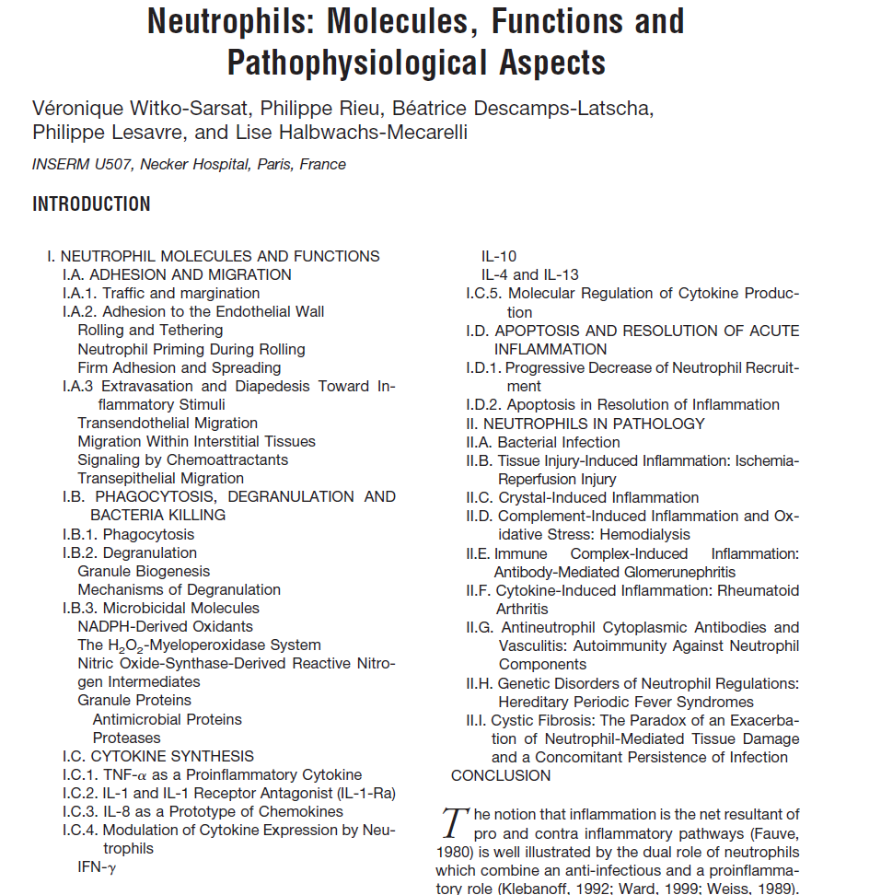
Witko-Sarsat V. et al., Laboratory Investigations, 2000, 80 (5): 617-653

Slide 11
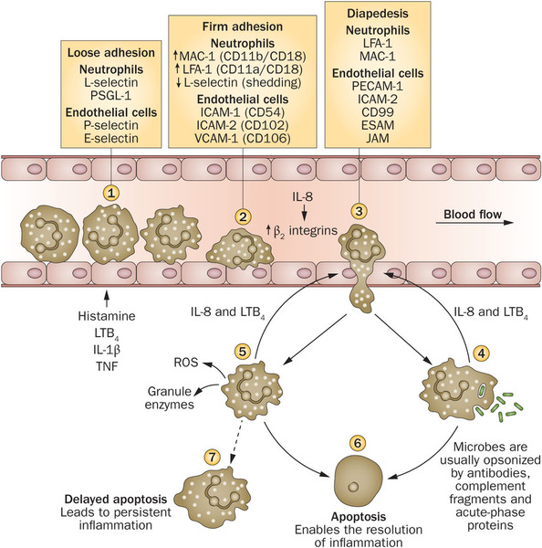

Slide 12


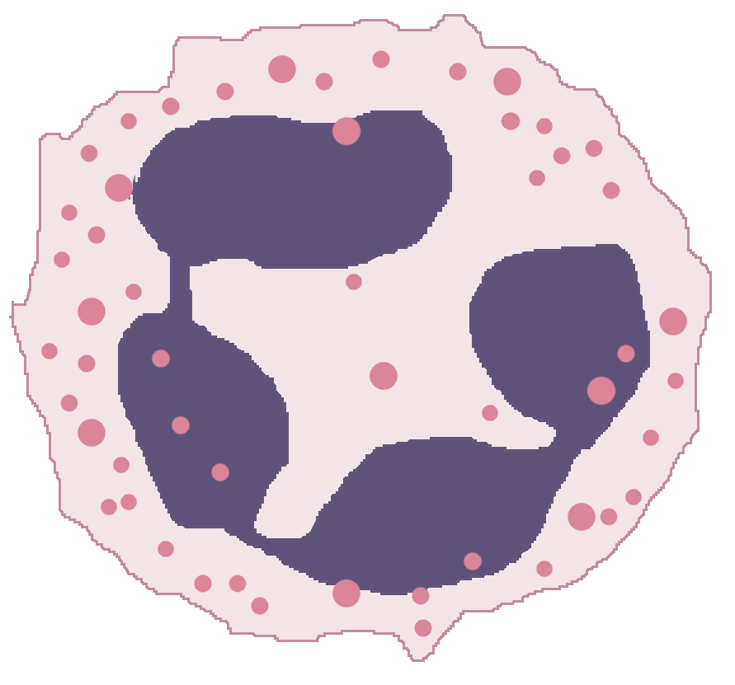
Neutrophils isolated from blood of healthy donors
CD 62L
CD 11b
IL-8
f-MLP or LPS
MMP-9
elastase
Investigation of the effect of
common privet aqueous
extracts on neutrophils
function in inflammatory state
MPO
ROS
H2O2
•O²⁻

Slide 13
Effect on reactive oxygen species (ROS) production
and myeloperoxidase release
aP <0.001 vs non stimulated control; *P< 0.001 vs stimulated control;

Slide 14
Effect on pro-inflammatory agents release
aP <0.001 vs non stimulated control;
*P< 0.001 vs stimulated control;

Slide 15
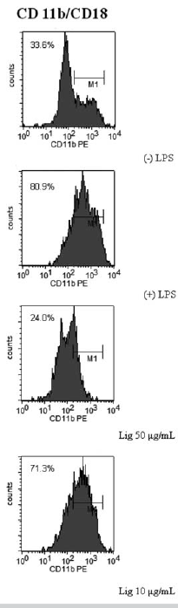
Effect on integrin β2 (CD 11b) surface expression

Slide 16
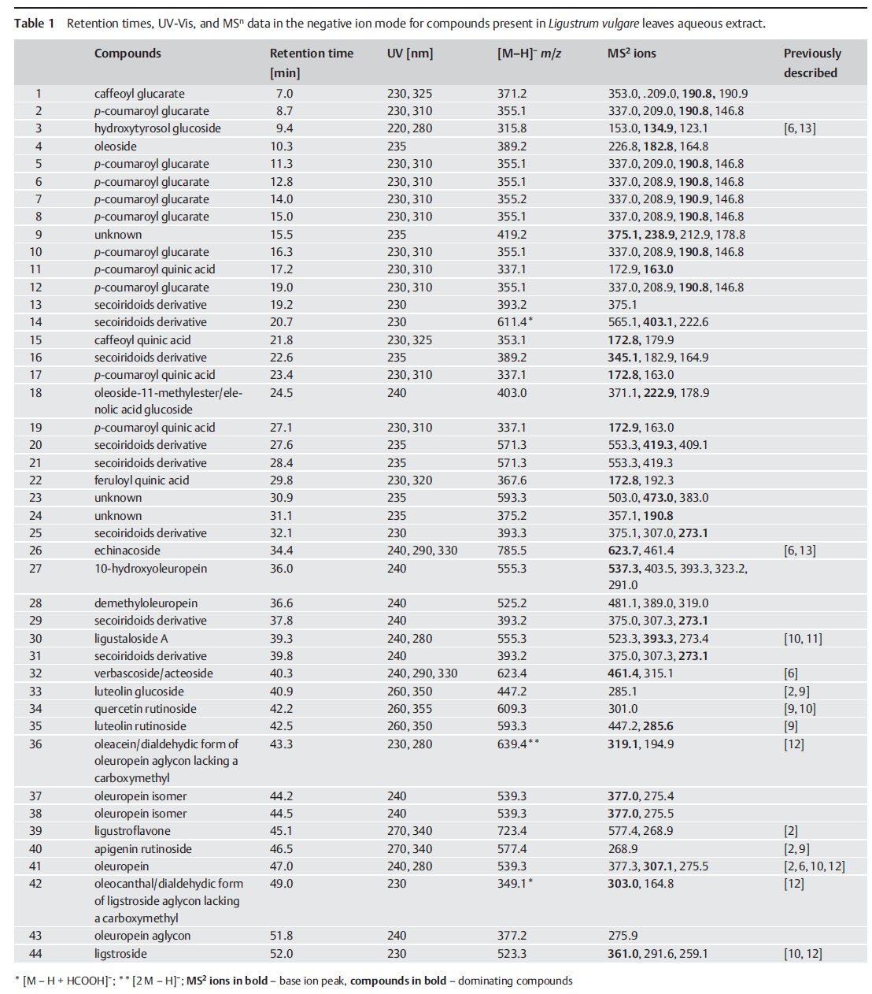
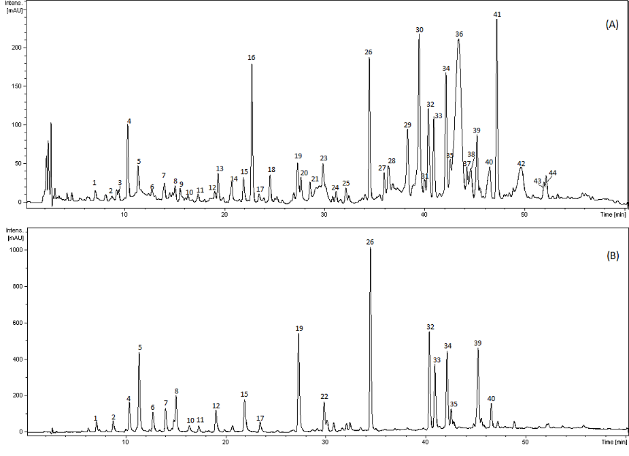
Analiza HPLC-DAD-MS/MS wyciągu wodnego

Slide 17
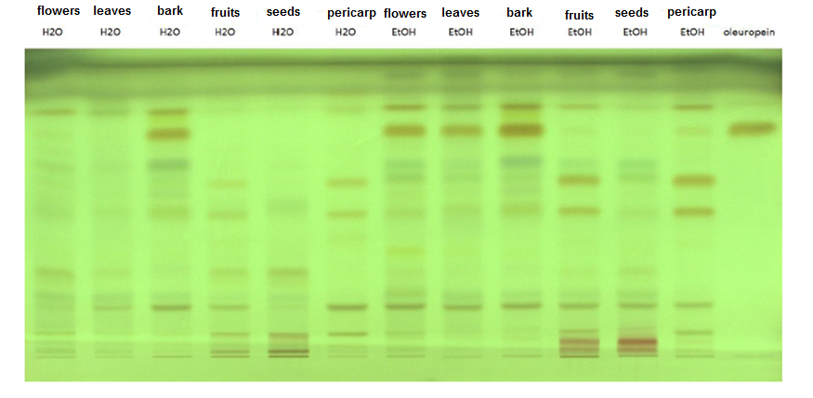
Chemical composition of parts o common privet
Silica gel was used as the stationary phase and dichloromethane:methanol:formic acid:water (80:25:1.5:4, v/v/v/v) as the mobile phase.
The plates were visualised using anisaldehyde (0.5%, methanolic) and sulphuric
acid (5%, methanolic), followed by heating at 105 °C for 10 min

Slide 18
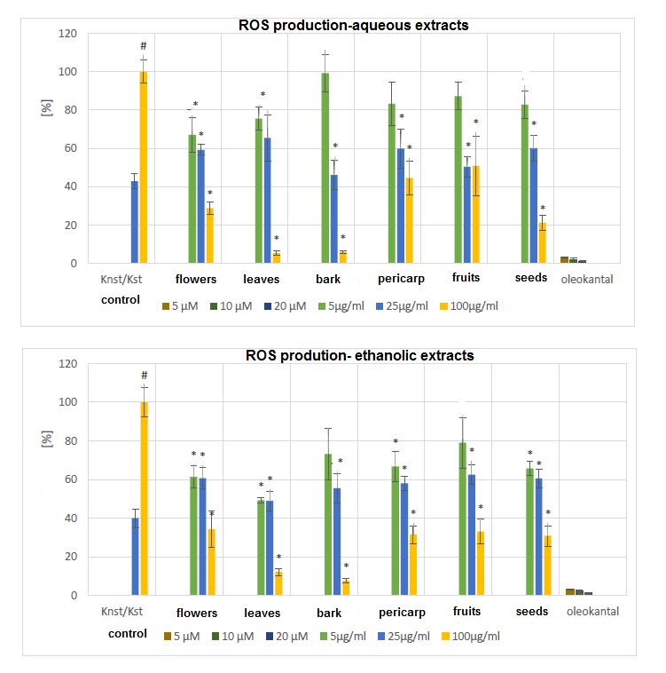
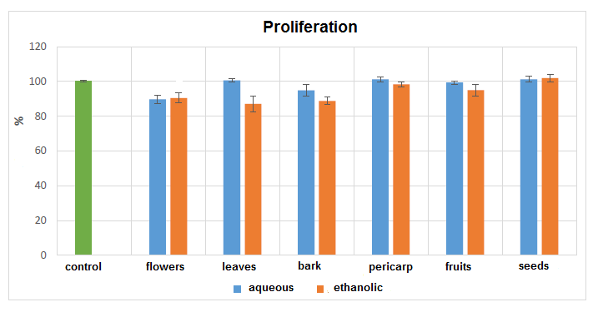
Comparison of biological activity of extracts from different of parts o common privet
#P <0.01 vs non stimulated control; *P< 0.01 vs stimulated control;

Slide 19
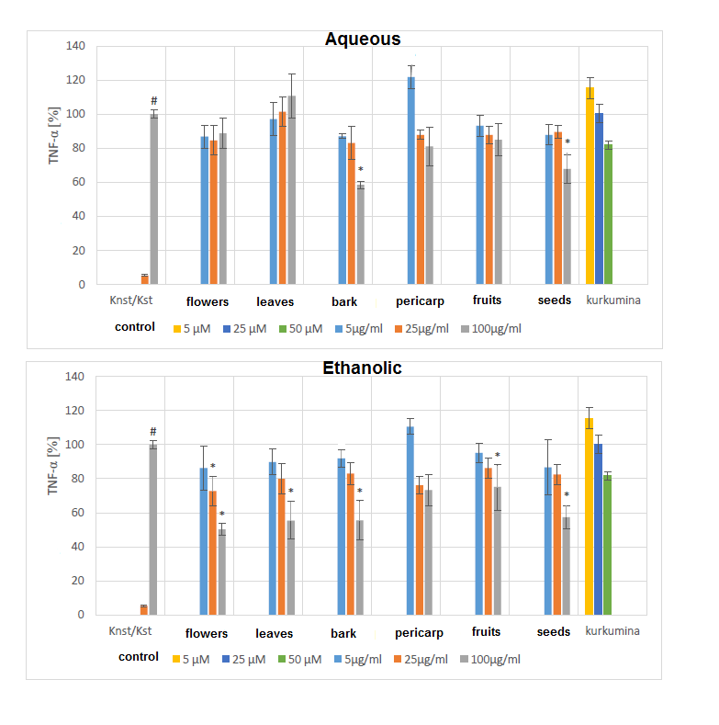
Comparison of TNF-α release inhibition by extracts from different of parts o common privet
#P <0.01 vs non stimulated control; *P< 0.01 vs stimulated control;

Slide 20
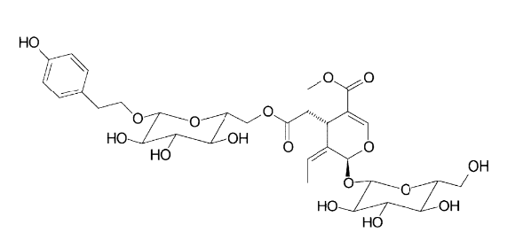
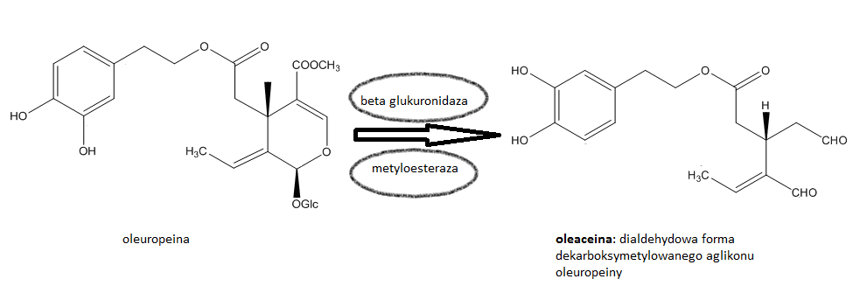
nuzhenide
oleuropein
oleacein

Slide 21
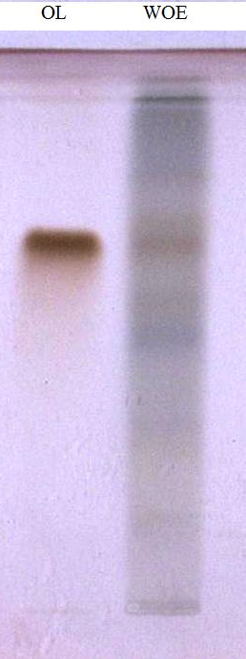
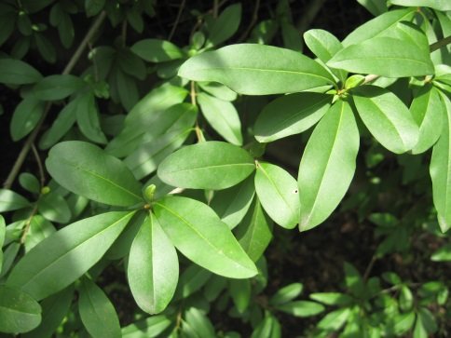
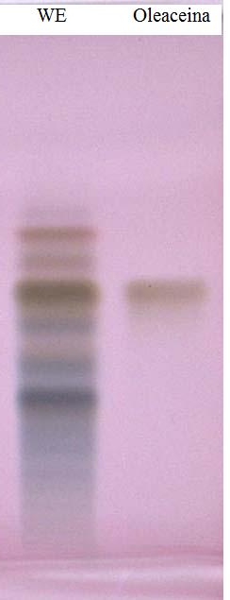
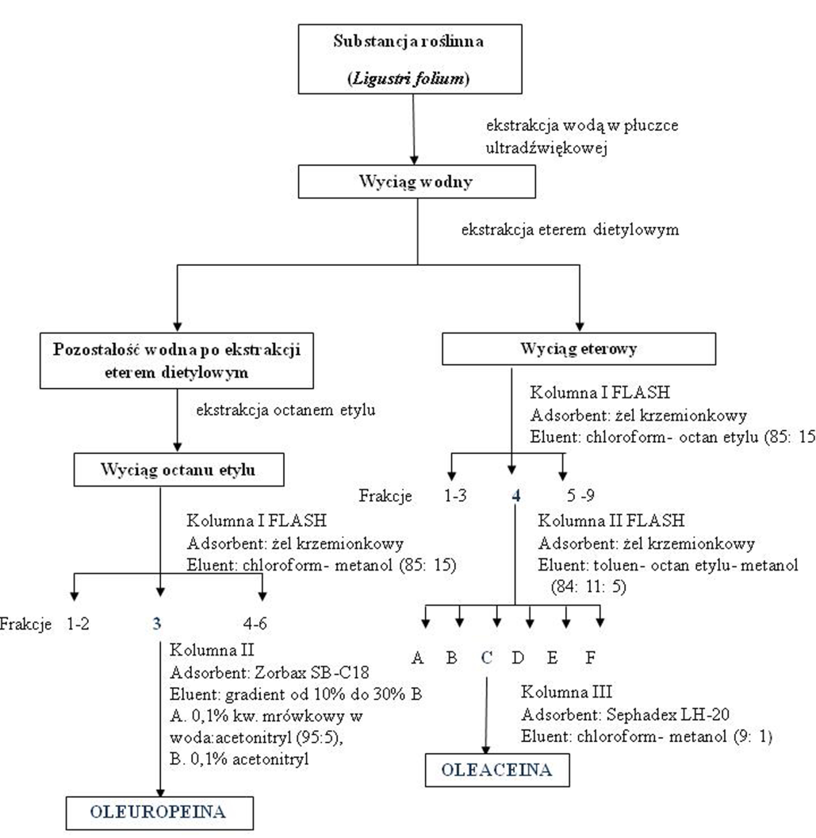
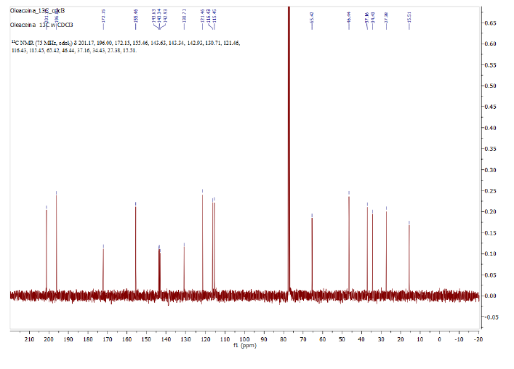
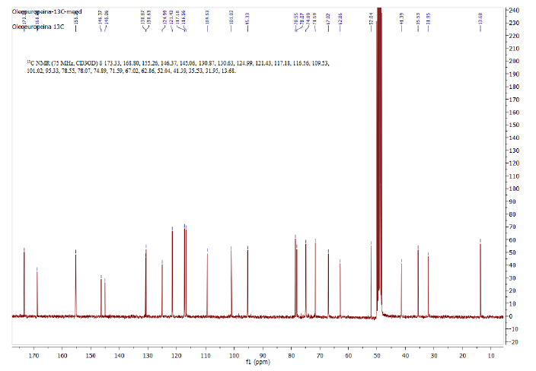

Slide 22
Comparison of biological activity
Neutrophils | Oleuropein [IC₅₀±SEM; µM] | Oleacein [IC₅₀±SEM; µM]
ROS (f-MLP stimulation) ROS (PMA stimulation) | 2,4±1,7 16,0±12,0 | 1,8±0,5 1,5±0,9
Myeloperoxidase release | 30,7±10,3 | 8,8±0,7
Neutrophils | Oleuropein 50 μM [Conc.±SEM] | Oleacein 50 μM [Conc.±SEM]
Elastase | 14.3±3.3 [%] | 27.7±4.1 [%]
MMP-9 | 13.5±3.0 [%] | 9.9±2.3 [%]
IL-8 | 26.0±3.8 [%] | 14.3±2.8 [%]

Slide 23
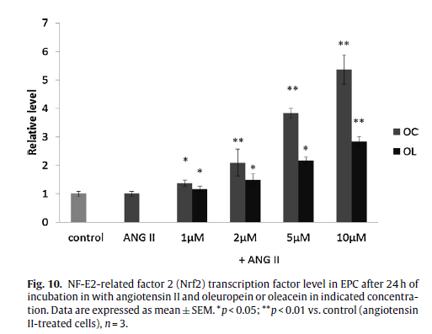

Comparison of biological activity

Slide 24
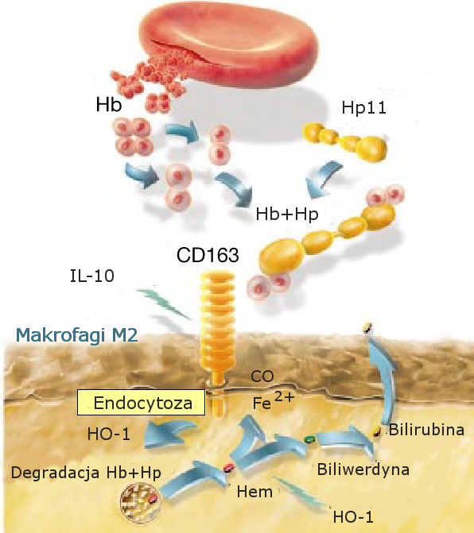
Scavenger receptor CD163 (M130, p155, HbSR)
Biomarker for anti-inflammatory macrophage M2
Function:
Uptake of heamoglobin/haptoglobin complexes (HbHp)
Expression induced by :
IL-10
TGF-β
glucocorticoids

Slide 25
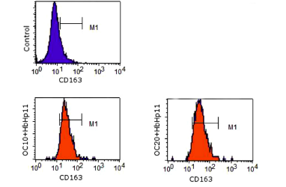
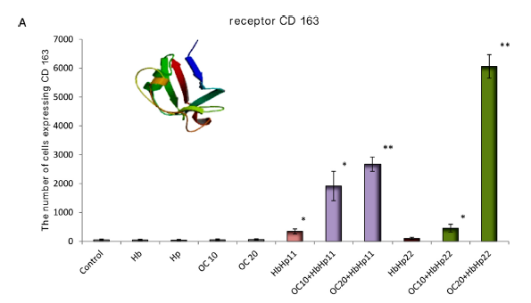
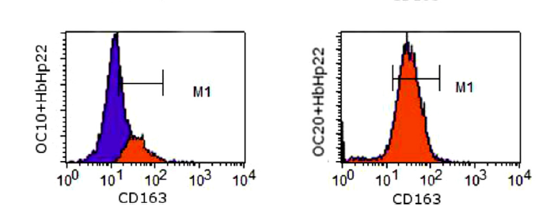
Effect of oleacein on the expression of CD 163 receptor

Slide 26
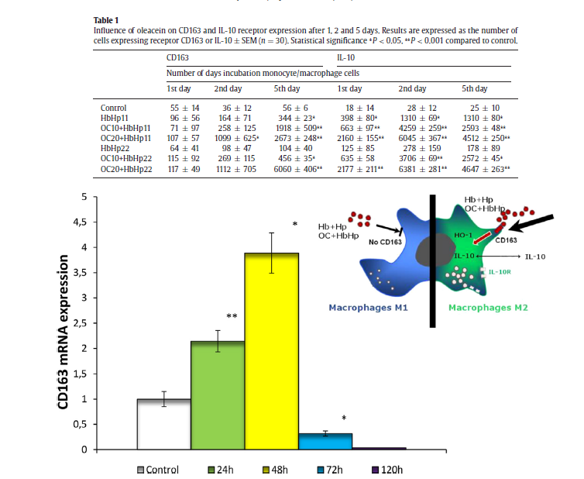
Effect of oleacein on the expression of IL-10 receptor

Slide 27
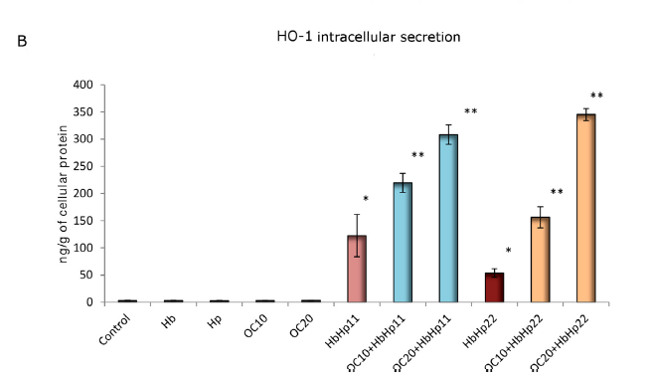
Effect of oleacein on the heme oxygenase OH-1
intracellular secretion

Slide 28
Summary
Ligustrum vulgare is an interesting source of active compounds- oleuropein and oleacein
Oleacein appears as an interesting anti-oxidant
and anti-inflammatory compound by stimulating the transition from M1 to M2 macrophages
However, the biggest challenge is to evaluate the bioavailability of this compound

Slide 29
Searching from plant growing in central Europe

Slide 30
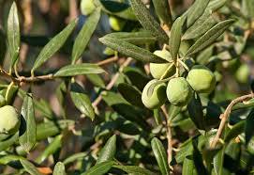
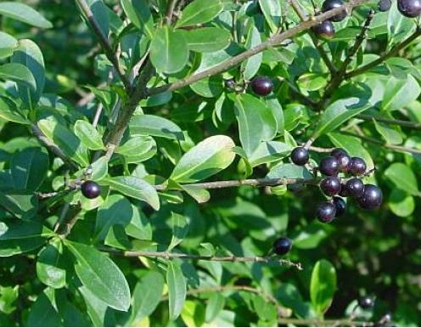
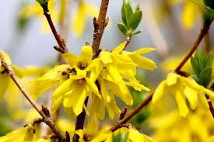
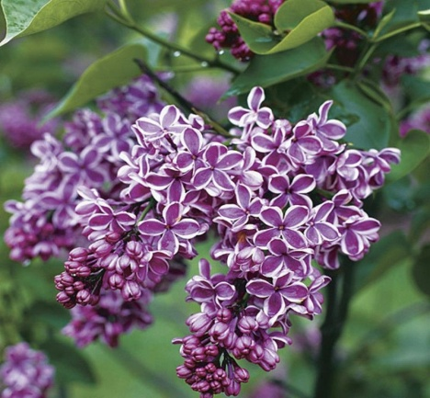
Olea leaves
Olea europaea
60% Ethanol Extract
Ligustrum leaves
Ligustrum vulgare
60% Ethanol Extract
Forsythia leaves
Forsythia flowers
Forsythia x intermedia
60% Ethanol Extract
Syringa leaves
Syringa flowers
Syringa vulgaris
60% Ethanol Extract

Slide 31
Effect of extracts on IL-8 production by human neutrophils
Notes:
Przeprowadzono badania cytotoksyczności – oznaczona metodą cytometrii przepływowej z użyciem jodku propidyny.

Slide 32
Effect of extracts on TNF-α production by human neutrophils

Slide 33
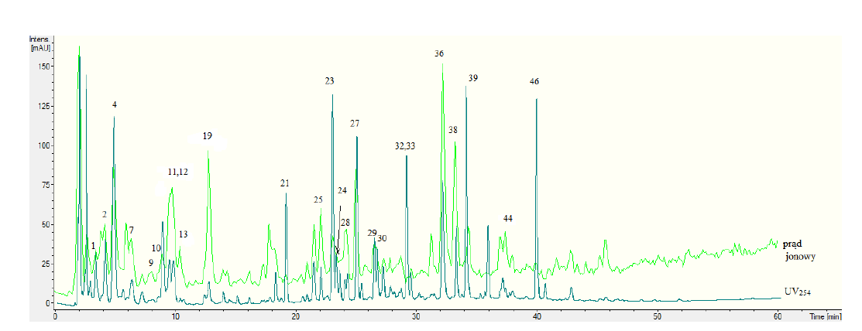
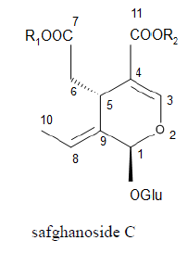
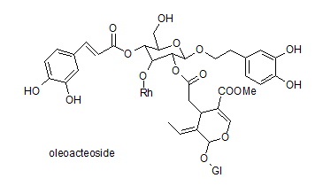
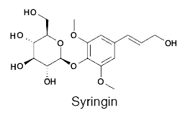
HPLC-DAD-MS/MS analysis

Slide 34
Syringa flowers
Syringa vulgaris
60% Ethanol Extract
Diaion HP-20 column
Fractions of different polarity
Biological research and TLC, HPLC-DAD-MS/MS analysis

Slide 35
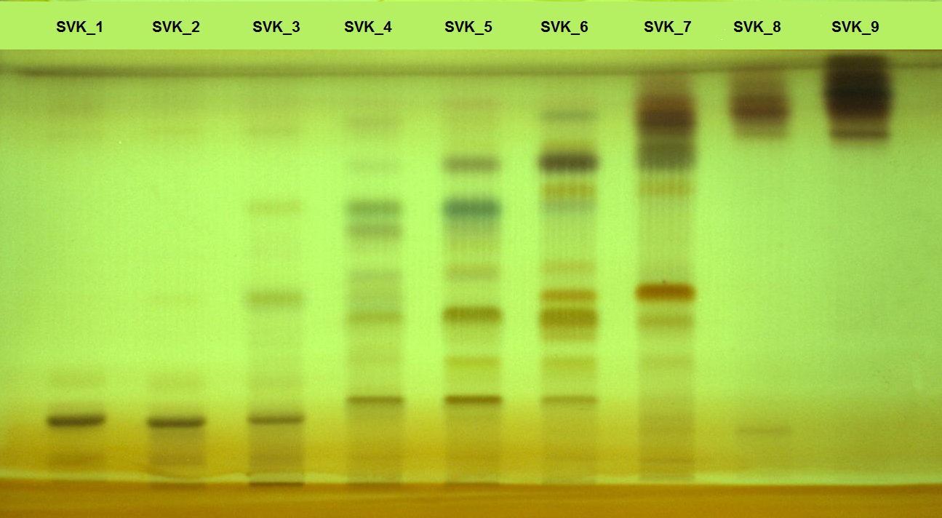
TLC analysis of obtained fractions
Silica gel was used as the stationary phase and
dichloromethane:methanol:formic acid:water (80:25:1.5:4, v/v/v/v) as the mobile phase.
The plates were visualised using anisaldehyde (0.5%, methanolic) and sulphuric
acid (5%, methanolic), followed by heating at 105 °C for 10 min

Slide 36
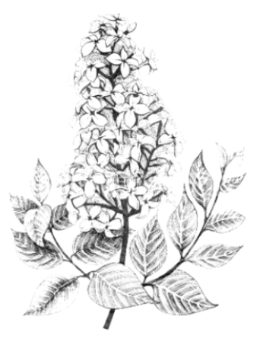
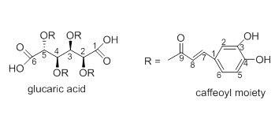

Fraction 1
Sephadex LH-20
50% MeoH
Fraction containing caffeoyl glucarates
Preparative chromatography C18
1-4 pure compounds

Slide 37

Fraction 6
Sephadex LH-20
35%; 50%; 70% MeoH
Fractions containing 1-5 single compounds
Preparative chromatography C18
18 pure compounds

Slide 38



Effect of single compounds on IL-8 production by human neutrophils

Slide 39

Summary
Oleaceae family (ligustrum and Syringa)- appear as an interesting source of active compounds, especially oleuropein/ secoiridoids derivatives
Due to different activity of different parts and fractions from the same plant material, it is necessary to isolate single compounds

Slide 40






Matthias F. Melzig
Marta Dudek
Marek Naruszewicz
Monika Czerwińska
Agnieszka Filipek
Andrzej Parzonko

Slide 41

Thank you for your attention

